Slide 1
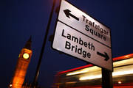
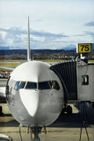
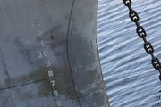
ANYTHING Private Limited Solution
Water transport & storage in emergency situation

Slide 2
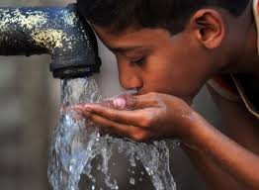
Water transport & storage division
The Need:
Disaster recovery plan by Water transport and storage solutions for humanitarian crisis events

Slide 3
Water transport & storage division
ANYTHING Water Crisis division provides water transport and water storage solutions to NGOs & relief organizations for disaster recovery by simple and affordable life-saving water solutions.
Technology solution by an Israeli professional logistic solutions provider by maintaining high standards of business ethics and professionalism since 1975.

Slide 4
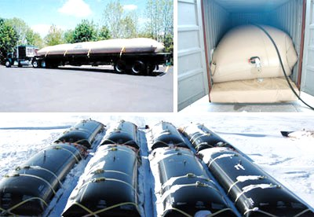
Water transport & storage division
Solutions & Services:
T-flex: Water transport tanks
Logistic container for quick response
Mobile Water Purification concept
Water distribution center
Personal water container
Temporary water farm

Slide 5
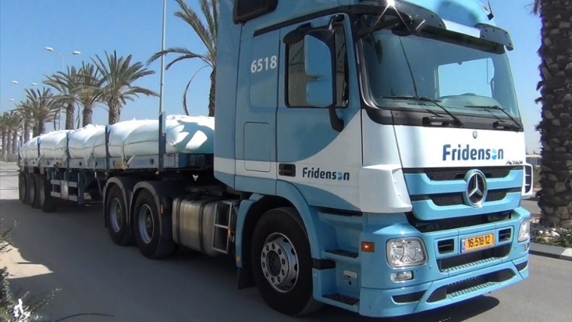
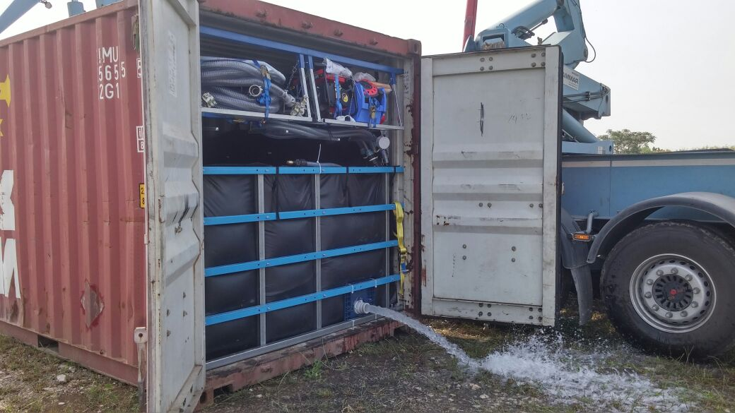
“T-Flex“ water transport tanks
Foldable pillow shaped tanks
Designed and manufactured for transportation
of liquids on standard truck-trailers,
mounted on flat bed trucks or in ocean containers

Slide 6
“T-Flex“ water transport tanks
Transport the water easily to location where people are concentrated
T-flex converts a standard truck to a TANKER in minutes!
Volume range: 24,000 lt
Robust design for safe transportation
Food Grade raw materials

Slide 7
Logistic Container for quick response
Population size of 50,000 people :
Daily water needs: 4 liter per person / day
Total daily quantity: 2,00,000 L
Single water station for: 2,500 people
Water station volume: 5,000 L
No. of water stations: 20
Water bladder size: 24,000 L
No. of water supplies: 3 daily rounds per station
No. of trucks: 3 flat bed trucks
Ocean container size: 40”

Slide 8
Logistic Container for quick response
Water station kit - Equipment details:
Protective cover for Water bag
Water bag – 5 m³
Press releases unit
Shtorz adaptor
Foldable stand for drinking fountain
Drinking fountain with 8 taps
Water hose - 3 meters
Carrying Case

Slide 9
Logistic Container for quick response
Mobile Water Purification device
Purification capacity – 2.1 liters/min (3,000 L/24Hrs)
No detergents/chemicals need – just filters replacement.
Level of polluted water source:
Nano filters remove 99.9999% of bacteria; 99.99% of viruses and 99.9% of cysts, and significantly reduce metals like mercury and lead.
Nano material reduces sediment, chlorine and total organic carbons (TOC’s) while preserving healthy minerals.
Energy – daily fuel consumption: 0.98 liters for
3.7 hours of operation (for 500 liters/day target).
14 liters of fuel will be sufficient for 15 days of
operation

Slide 10
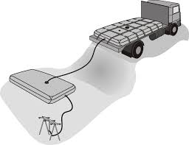
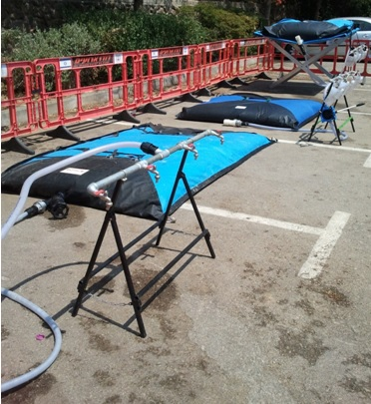
Water distribution center
Distribution system includes pillow, platform and drinking fountain.
Ready for deployment
Easy set-up anywhere
Serves large number of people simultaneously

Slide 11
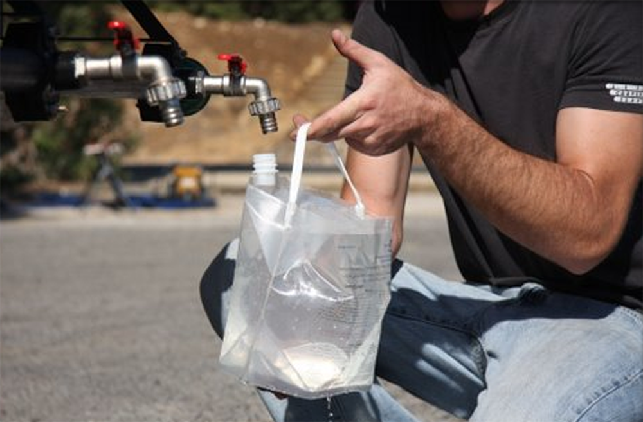
Personal water container - an option
Personal water container helps people to carry the potable water home
Robust & lights weight
In range of 4 – 6 lt.
Environmental friendly

Slide 12
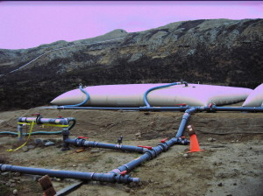
Temporary water farm
In a range of sizes from 5,000 USG
(20,000L) to 250,000 USG (1,000,000L)
for each tank.
Multiple tanks can be connected
together through a manifold system
to create a cost-effective tank farm
with unlimited capacity.

